Slide 1
“ MINI PROJECT- Hand Gesture Controlled Robot using Arduino.
Done by :
Dhiyaneshkv [2019105524]

Slide 2
ABSTRACT:
Gesture Controlled Car is a robot which can be controlled by simple human gestures. The user just needs to wear a gesture device in which a sensor is included. The sensor will record the movement of hand in a specific direction which will result in the motion of the robot in the respective directions. The robot and the Gesture instrument are connected wirelessly through radio waves. User can interact with the robot in a more friendly way due to the wireless communication. We can control the car using accelerometer sensors connected to a hand glove. The sensors are intended to replace the remote control that is generally used to run the car. It will allow user to control the forward, backward, leftward and rightward movements, while using the same accelerometer sensor to control the throttle of the car. Movement of car is controlled by the differential mechanism. The mechanism involves the rotation of both forth & rear wheels of left or right side to move in the anticlockwise direction and the other pair to rotate in the clockwise direction which makes the car to rotate about its own axis without any kind of forward or backward motion. The main advantage of this mechanism is the car with this mechanism can take sharp turn without any difficulty.

Slide 3
Components used :
Arduino uno (Receiver and transmitter)
RF pair module (receiver and transmitter)
L293D Motor driver module(Receiver)
ADXL335 SENSOR (accelerometer(transmitter))
Car body with motor.
1.chasis.
2.motor with 100 RPM.
3. caster wheel .
4.mini bread board .
5.Jumper wires (m-f).
6. And pair of 9V battery for power source.

Slide 4
Hardware and software used :
This is a hardware project which consist the above mentioned parts .
In this part the overall project of Hardware is divided into 2 parts.:
1.Hand (Transmitter)
2. car body (Receiver)
The software which is used for this project is Arduino IDE
Which run’s using C++.

Slide 5
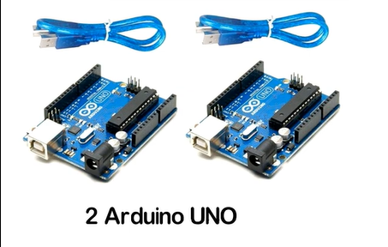
ARDUINO UNO:
Arduino uno , which is the microcontroller used to control all the process going through the whole system .it is an open source hardware and software controller .the language which we are going to use is C/C#. We use 2 board because one for the car bot And the other in hand . we connect it to our computer and program it and do the further process by running it .and applying it to the used components.

Slide 6
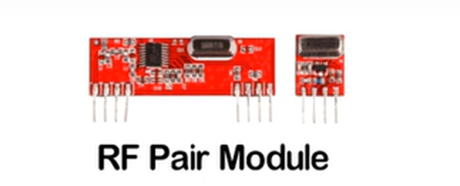
RF pair module (receiver and transmitter):
An RF module (short for radio-frequency module) is a small electronic device used to transmit and/or receive radio signals between two devices.
RF pair module is the transmitter and receiver used for this project where 1 part is connected to the hand Arduino board and other to the bot ,which collects the received data from the other part .
Its is 433MHz
So without antenna min range (3 meter ) and max will be (100 meter )with antenna.

Slide 7
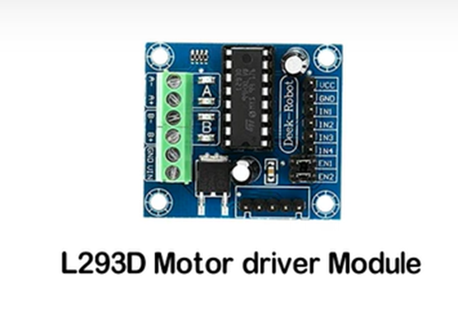
L293D Motor driver module:
L293D is a typical Motor driver or Motor Driver IC which allows DC motor to drive on either direction. L293D IS 16 PIN IC which drive 2 motors simultaneously in 2 different direction.

Slide 8
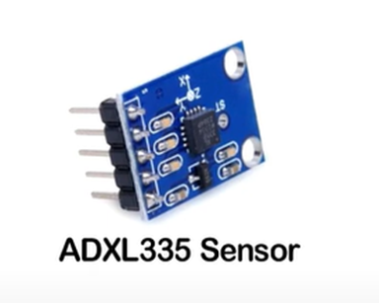
ADXL335 SENSOR (accelerometer ):
The ADXL335 is a small, low power, complete 3-axis accelerometer with signal conditioned voltage outputs. It finds the axis’s (X,Y,Z) and send data so that we can calculate the angle at what hand moves and then send the data to bot so that it can decied its path using code written in Arduino.

Slide 9
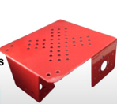
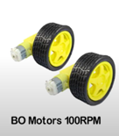
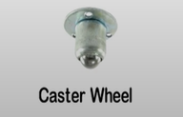
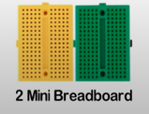
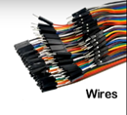
Car body with motor:
1.chasis
2.motor with 100 RPM
3. caster wheel
4.mini bread board
5.Jumper wires (m-f)
6. And pair of 9V battery for power source.

Slide 10
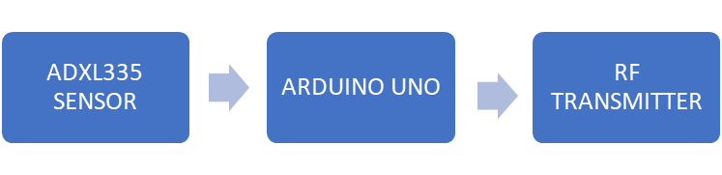

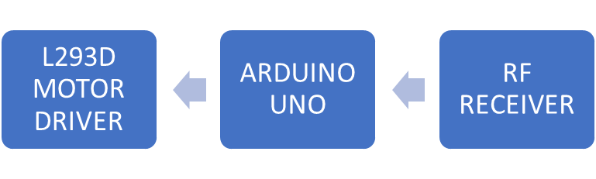

BLOCK DAIGRAM:
Transmitter (hand)

Slide 11
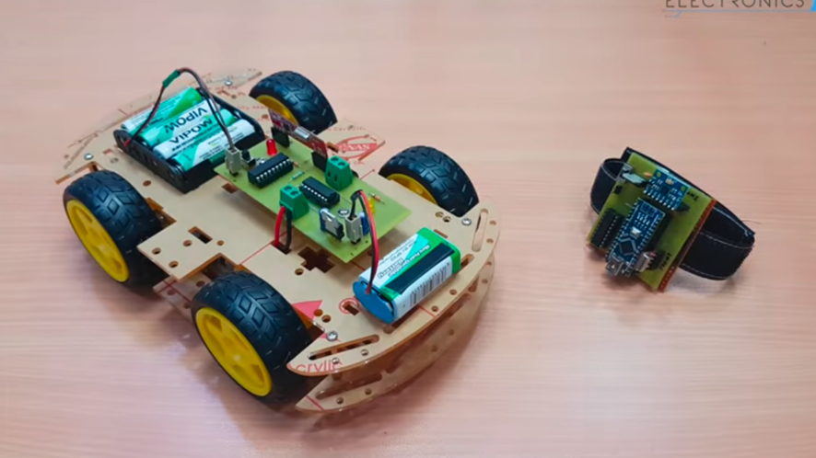
EXAMPLE MODEL:

Slide 12
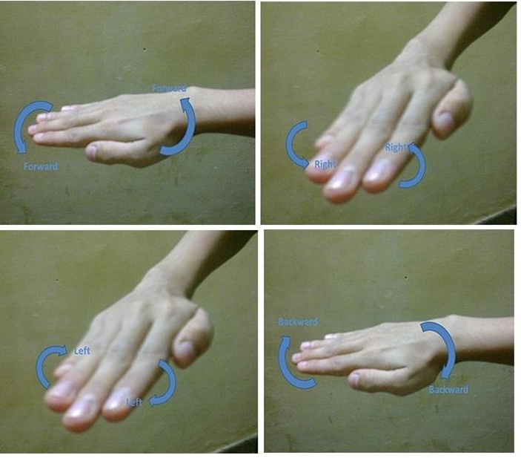
HAND GESTURES:

Slide 13
Project division
This project is divided into 2 sections
1. Transmitter
2. Receiver

Slide 14
Transmitter
This part is presented in the hand which detects the hand gesture and send the signal.
Here the components are ARDUINO , RF pair module, ADXL335 SENSOR
The sensor receives the hand gesture (X,Y,Z) values and send the data to Arduino and Arduino send’s the data to the car part using the RF pair module

Slide 15
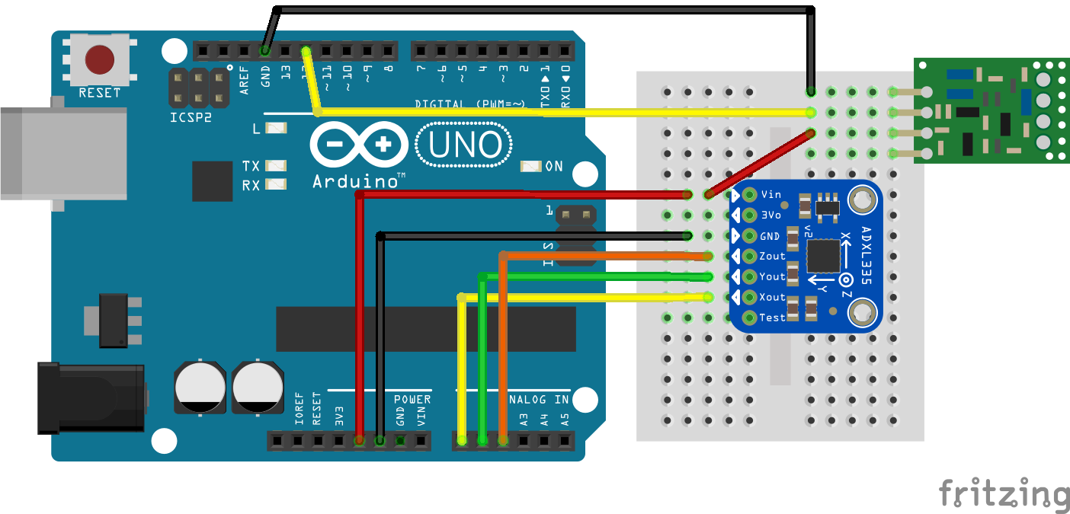
Circuit diagram

Slide 16
Receiver
This part is presented in the car body which detects the data from hand part and drives the car .
Here the components are ARDUINO, RF pair module, L293D Motor driver module
The RF module receives data from other unit from hand part and send the data to Arduino and Arduino send the data to L293D motor driver module and it control’s the wheel accordingly to the code. Written

Slide 17
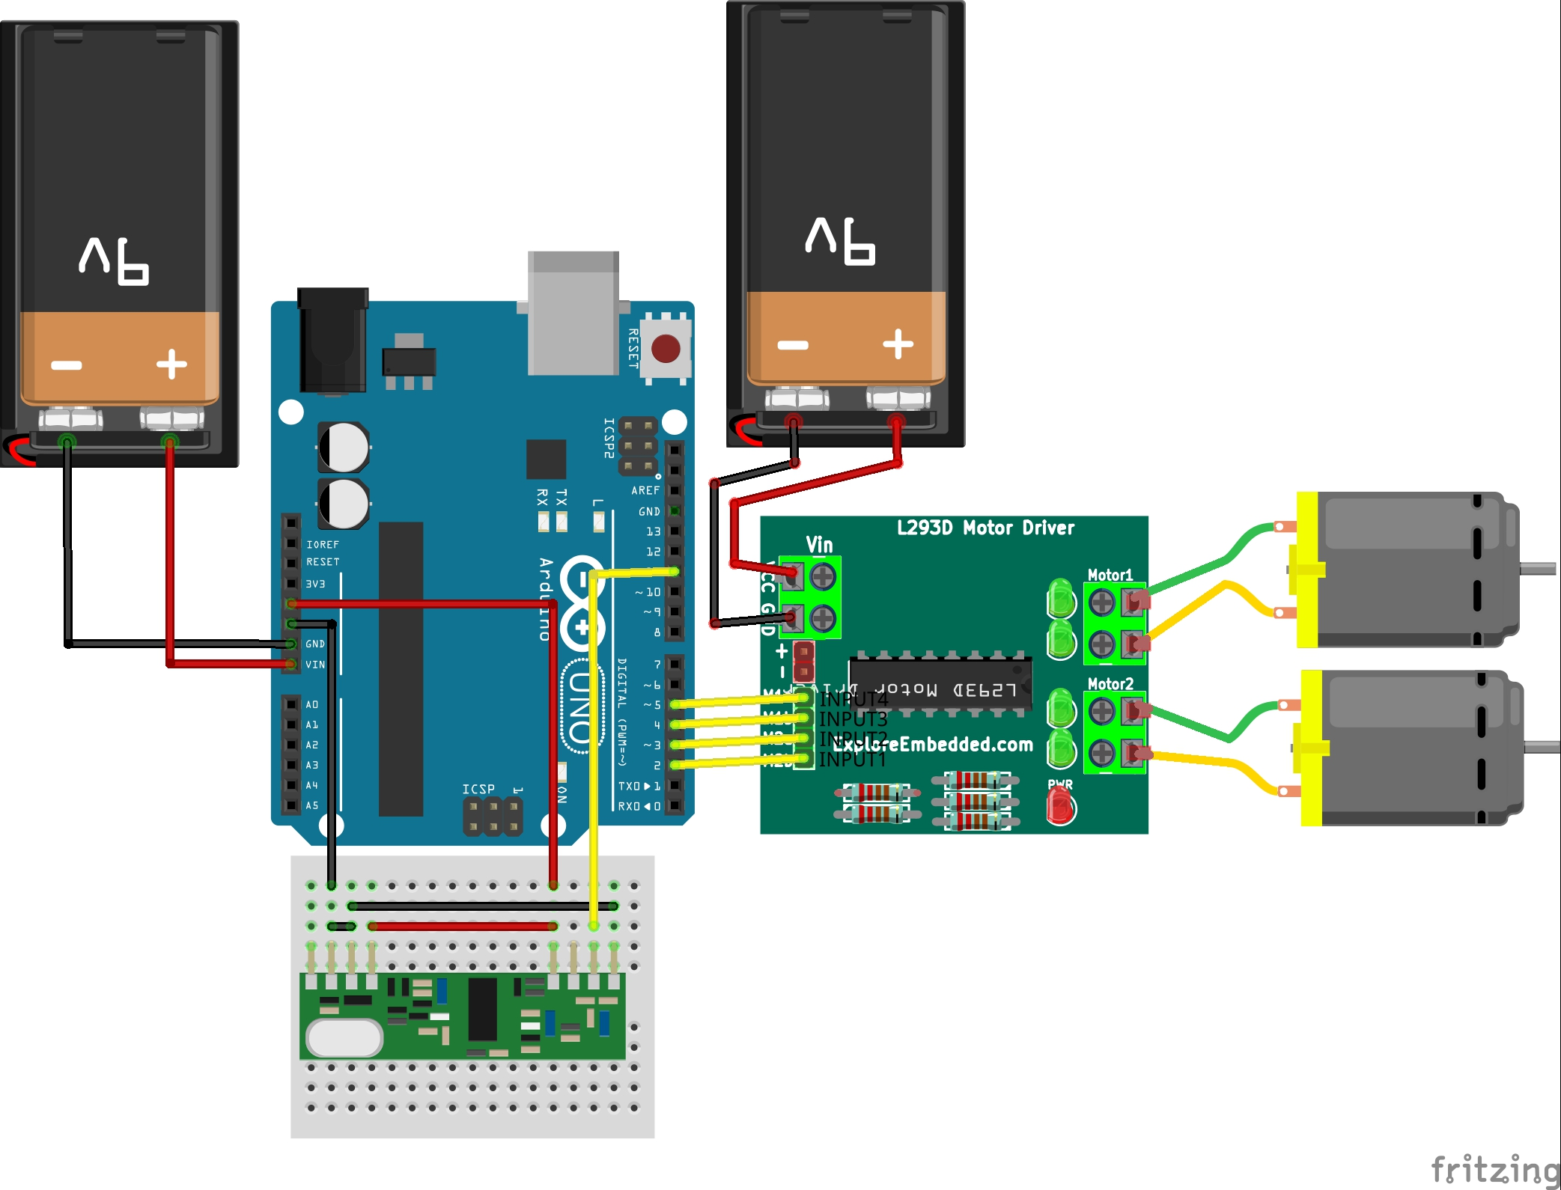
Circuit diagram

Slide 18
Conclusion
Here the robot which we have designed is a simple concept of hand gesture controlled activities ,where we use a sensor to detect at which angle does our and hand move and send the value of (X,Y,Z) to the Arduino and the microcontroller send’s the data to the other micro controller (in car body)
Using RF pair module which consist of 2 part transmitter and receiver at its position and send’s the data to Arduino and Arduino send the data to drover shield to control the wheels accordingly

Slide 19
FUTURE SCOPE
The proposed system is applicable in hazardous environment where a camera can be attached to the robot and can be viewed by the user who is in his station. This system can also be employed in medical field where miniature robot are created that can help doctors for efficient surgery operations
It also having proposed utility in field of construction, Military war etc.

Slide 20
Future Ideas:
. The design and implementation of a gesture control robotic arm using flex sensor is proposed. The robotic arm is designed in such a way that it consists of four movable fingers, each with three linkages, an opposing thumb, a rotating wrist and an elbow. The robotic arm is made to imitate the human hand movements using a hand glove.

Slide 21
REFERENCES
[1] Diksha Goyal , Dr. S.P.S. Saini ,” Accelerometer Based Hand Gesture Controlled Wheelchair”, in International Journal on Emerging Technologies , Vol. 2,2013
[2] Amornched Jinda-apiraksa, Warong Pongstiensak, and Toshiaki Kondo,” A Simple Shape-Based Approach to Hand Gesture Recognition , Electrical Engineering/Electronics Computer Telecommunications and Information Technology (ECTI-CON), 2010 International Conference on 2010
[3] Akira Utsumi, Tsutomu Miyasato and Fumio Kishino,” MultiCamera Hand Pose Recognition System Using Skeleton Image”, Robot and Human Communication, 1995. RO-MAN'95 TOKYO, Proceedings., 4th IEEE International Workshop on 1995
[4] J. Davis, M. Shah, “Visual gesture recognition”, IEEE Proc.-Vis. Image Signal Process., Vol. 141, No. 2, April 1994

Slide 22
THE END
THANK YOU
SUBBMITTED BY :
Dhiyaneshkv(2019105524)

